Slide 1
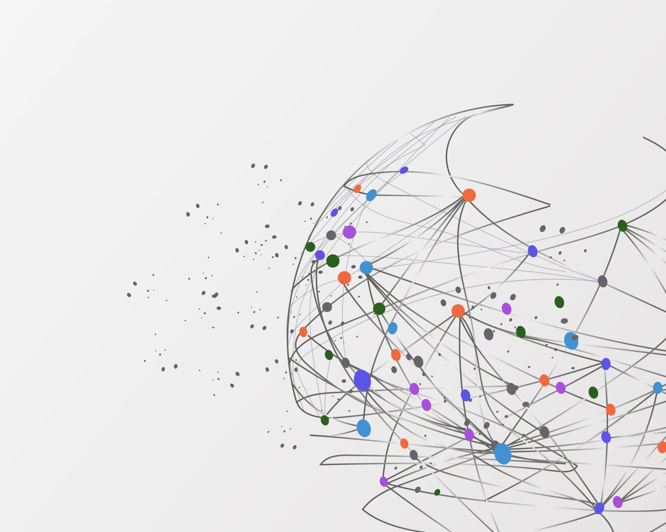

Biweekly Progress
Customer Lifetime Value Prediction
Shashwat Dhayade

Slide 2
Planned vs Completed/Pending
PLANNED
Finish Data Cleaning
Make a Base Model based on RFM Strategy
Feature Engineering
Completed
Finish Data Cleaning
Make a Base Model based on RFM Strategy
Feature Engineering
Correlation Matrix
Scaling and Modeling

